Slide 1
Unit 1 Part A(2) My day
五年级(下)

Slide 2

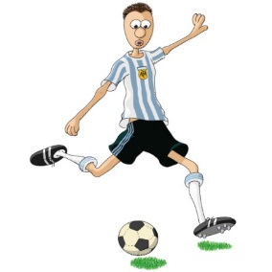
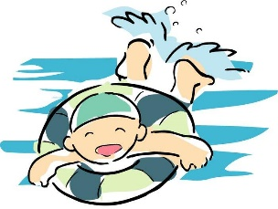
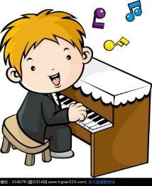
What do you do on the weekend?
I often…

Slide 3
always often usually sometimes
always 表示约 100% usually 表示约80%
often 表示约60% sometimes 表示约40%

Slide 4
A: What do you do on Saturday/on Sunday/on the weekend?
B: I always/usually/often/sometimes…
go for a walk | 80%
clean the room | 60%
go shopping | 40%
play football | 60%
draw cartoons | 80%
take a dancing class | 60%
read books | 100%
do homework | 100%
watch TV | 80%
play the pipa | 40%

Slide 5
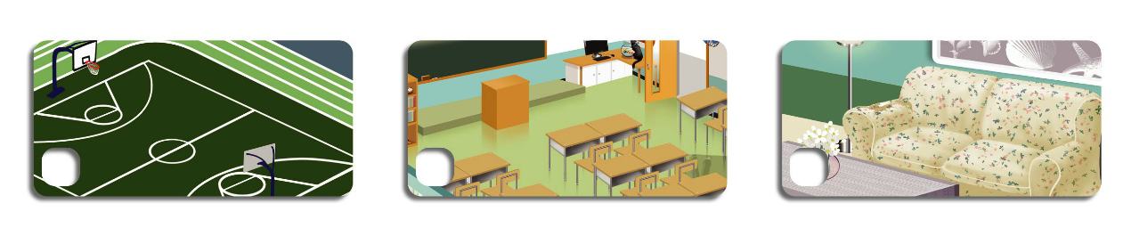
Let's try
Where are Zhang Peng and Pedro? Listen and tick.

Slide 6
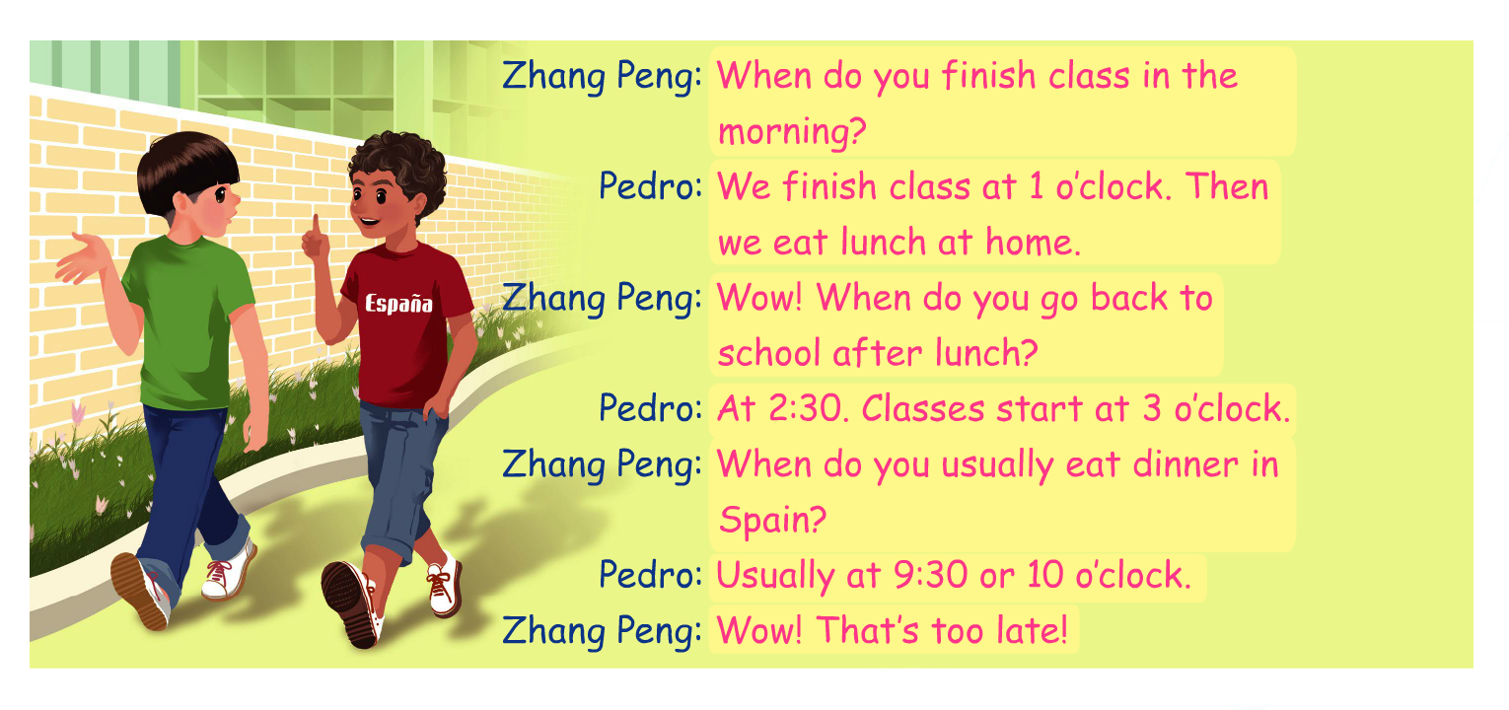
Let's talk

Slide 7
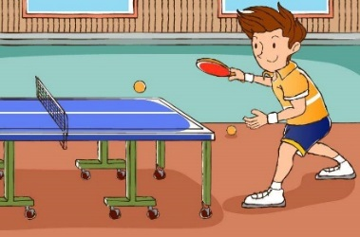


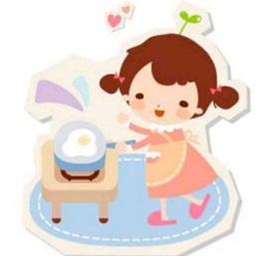
Let's talk
When do you… ?
4:00 p.m.
I play ping-pong at 4:00.
9:30 a.m.
I read books at 9:30.
17:30 p.m.
I cook at 17:30.

Slide 8
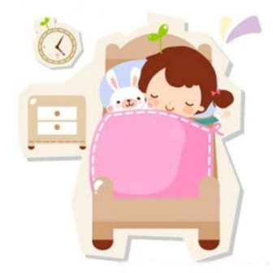
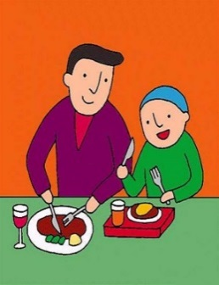
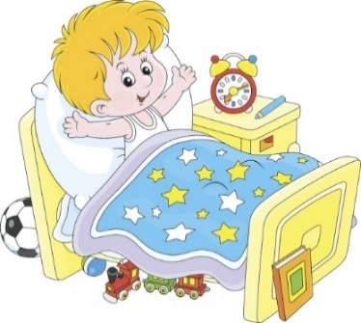
Let's talk
——When do you (usually)… ? ——I (usually) …
两人一组进行对话
go to bed
eat lunch
get up

Slide 9
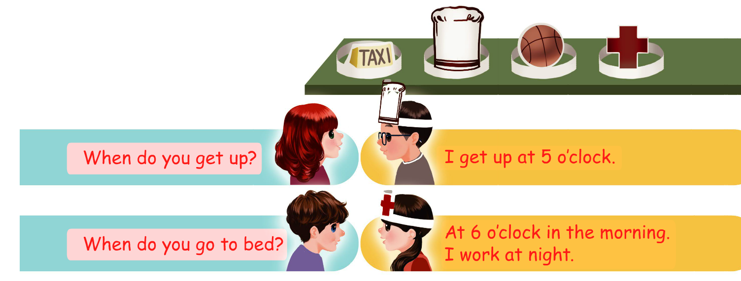
Role-play

